Slide 1
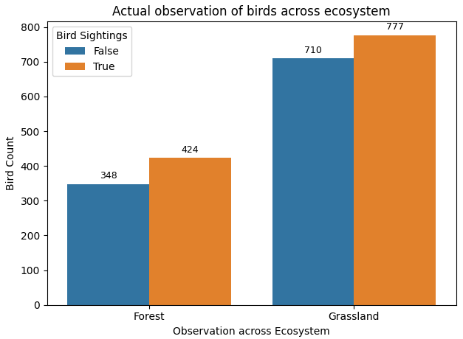
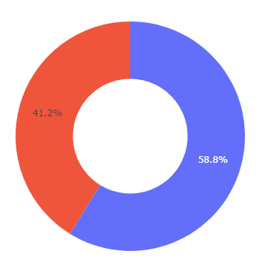

INITIAL ANALYSIS
Total observations across Ecosystem

Slide 2
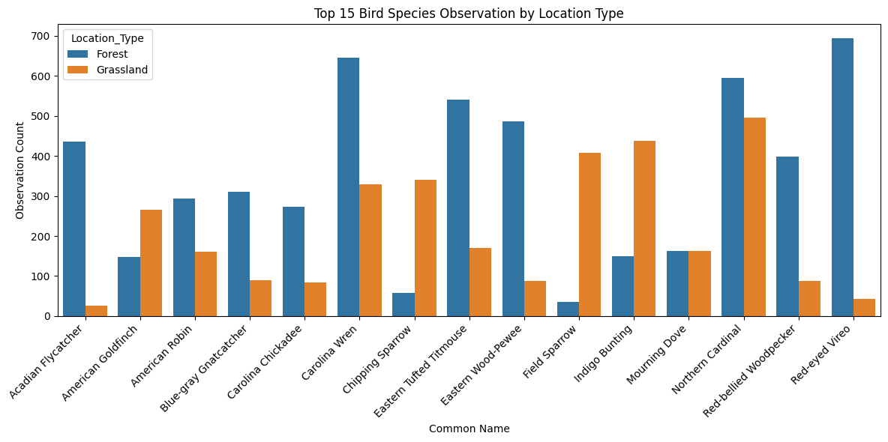
BIRD SPECIES DISTRIBUTION ACROSS LOCATION

Slide 3
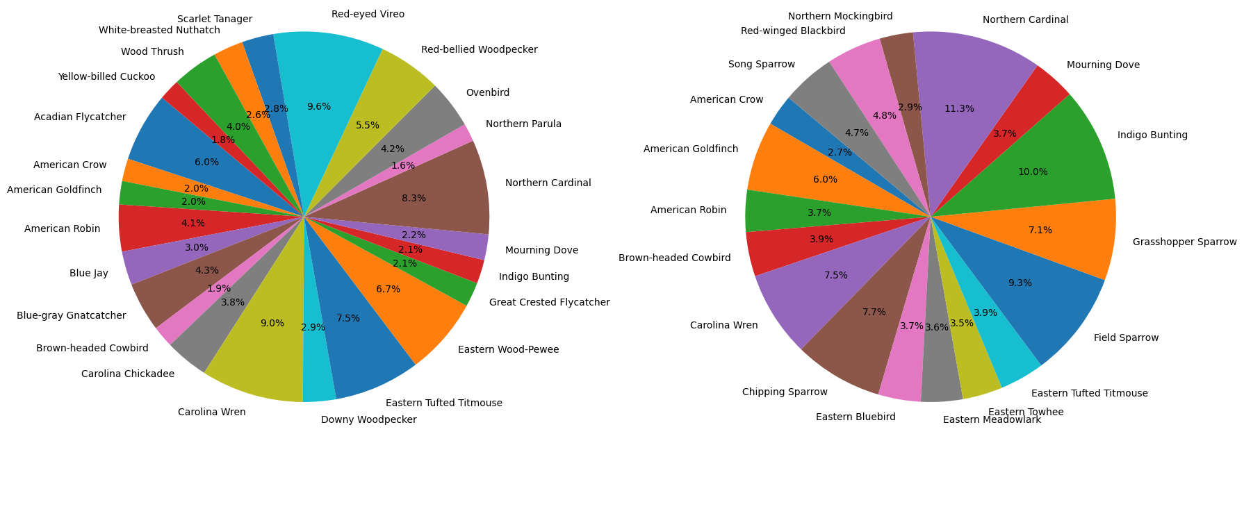
BIRD SPECIES DISTRIBUTION ACROSS ECOSYSTEM
Species Proportion - Forest
Species Proportion - Grassland

Slide 4
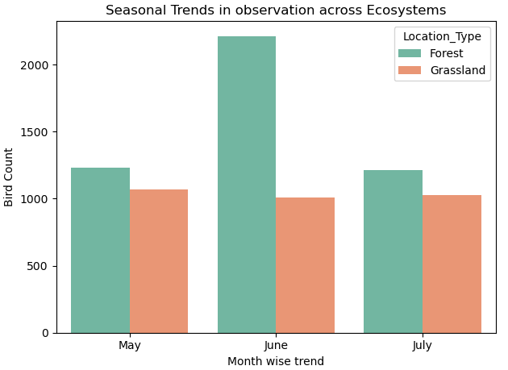
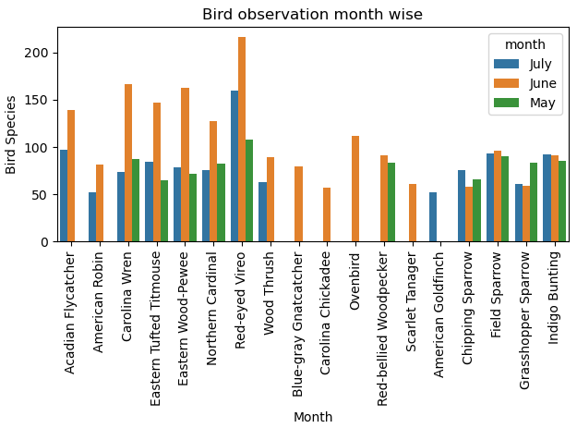
TEMPORAL ANALYSIS - MONTH

Slide 5
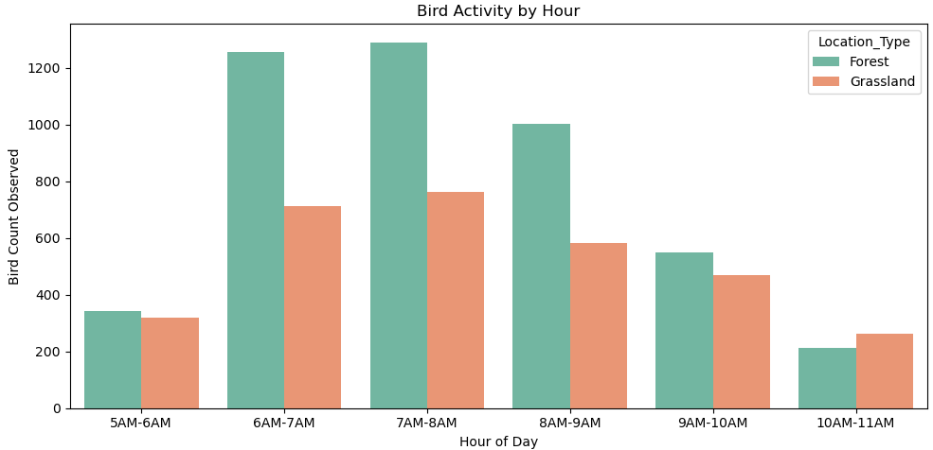
TEMPORAL ANALYSIS - HOUR

Slide 6
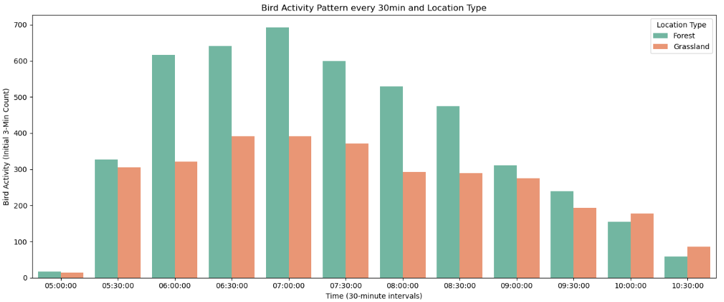
TEMPORAL ANALYSIS – HALF-HOUR

Slide 7
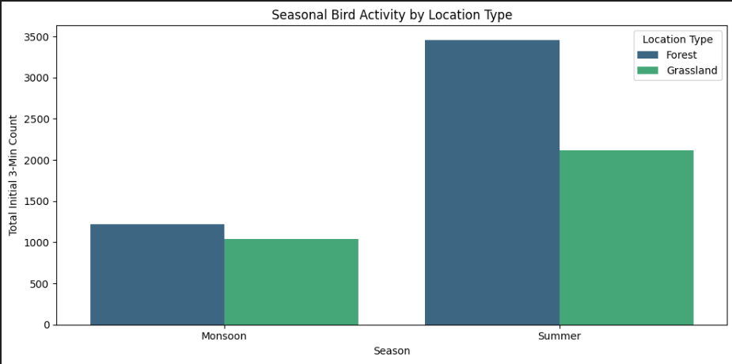
TEMPORAL ANALYSIS – SEASON

Slide 8
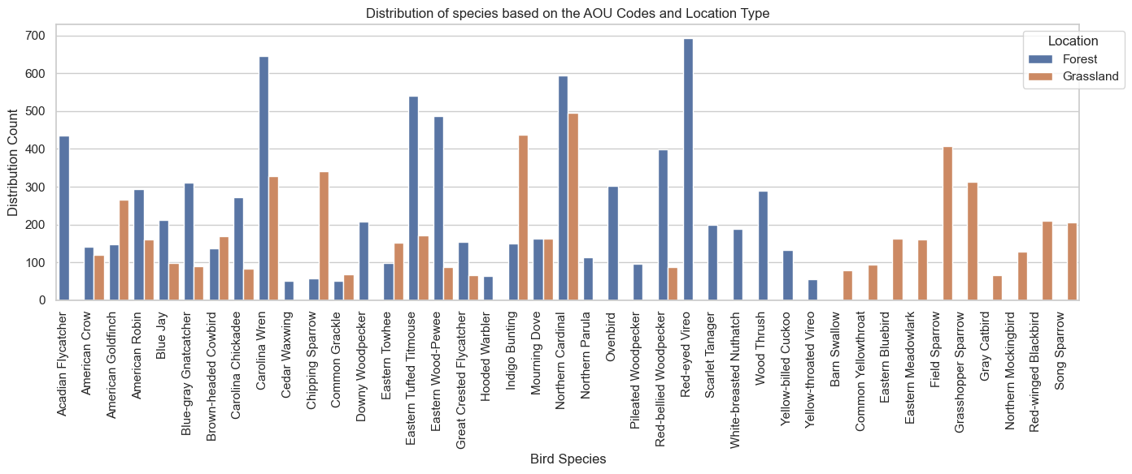

Slide 9
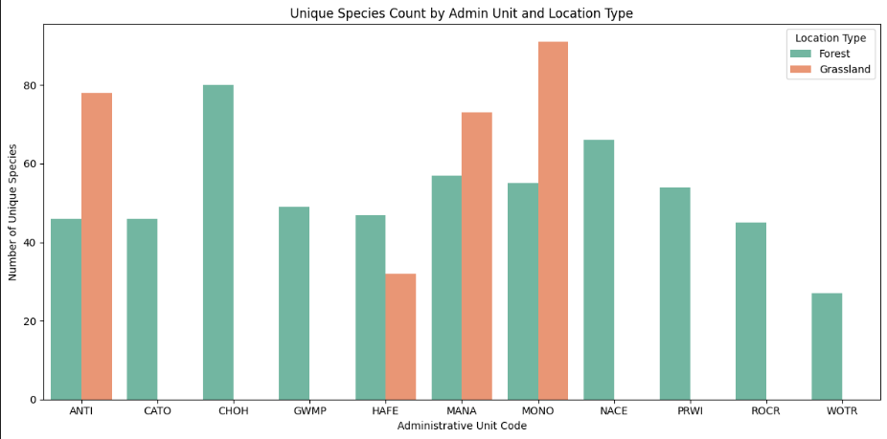
This bar chart shows the top 15 bird species in both forest and grassland ecosystems

Slide 10
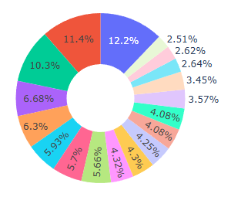
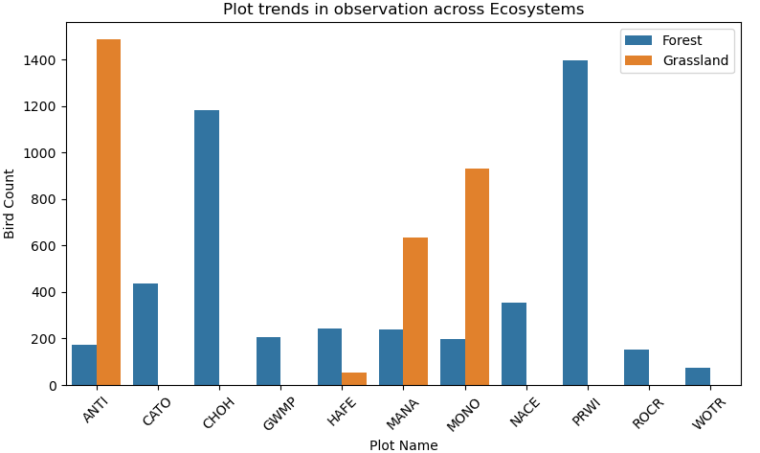
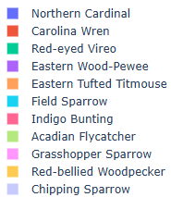
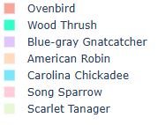
SPATIAL ANALYSIS

Slide 11
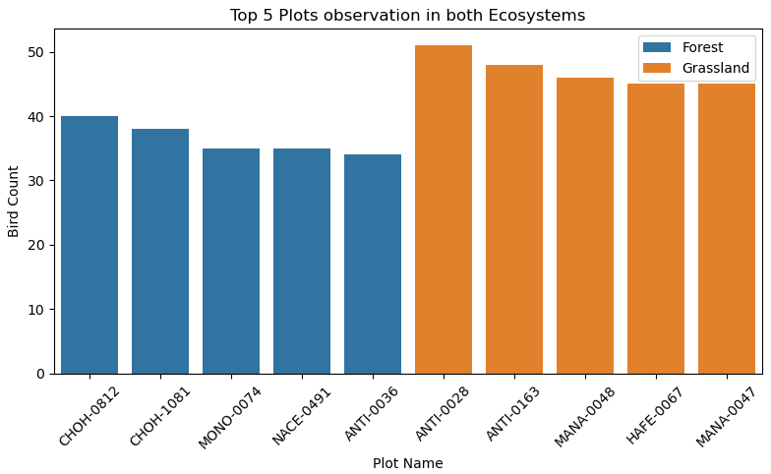
SPATIAL ANALYSIS

Slide 12
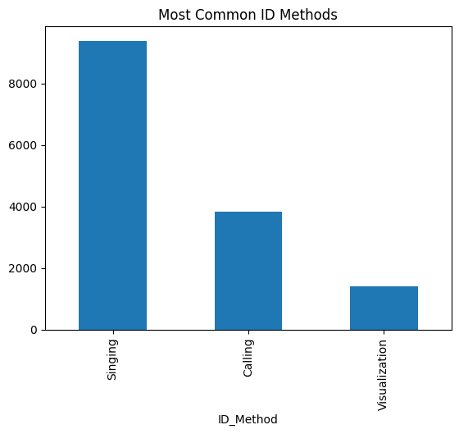
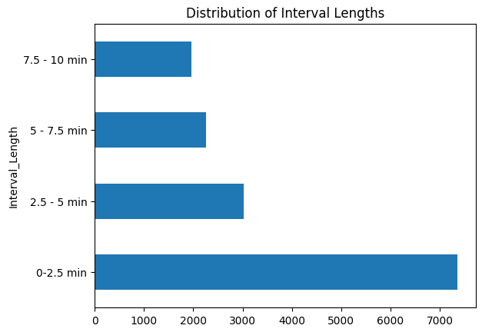
SPECIES ANALYSIS

Slide 13
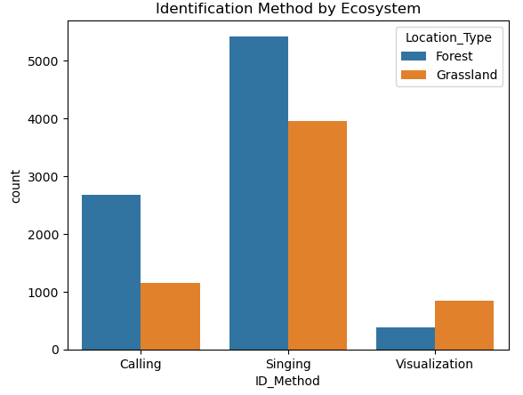
SPECIES ANALYSIS

Slide 14
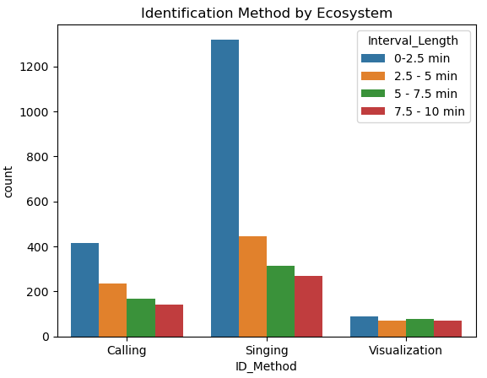
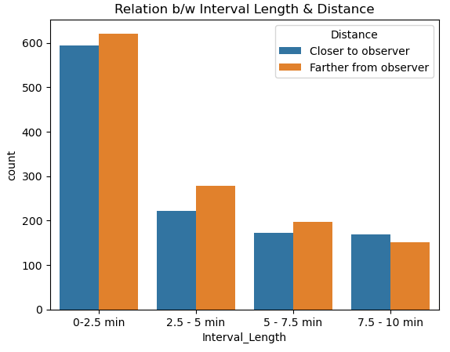
SPECIES ANALYSIS

Slide 15
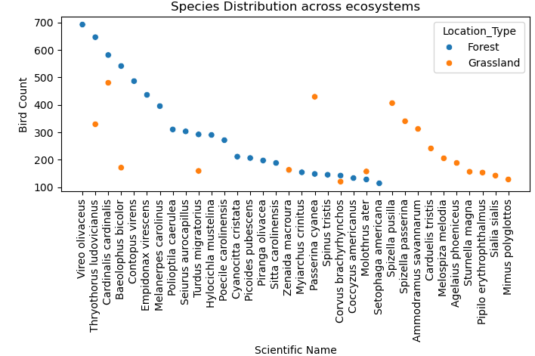
SPECIES ANALYSIS
Note:
Species count more than 100 are taken into consideration

Slide 16
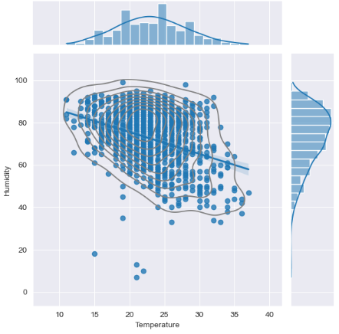
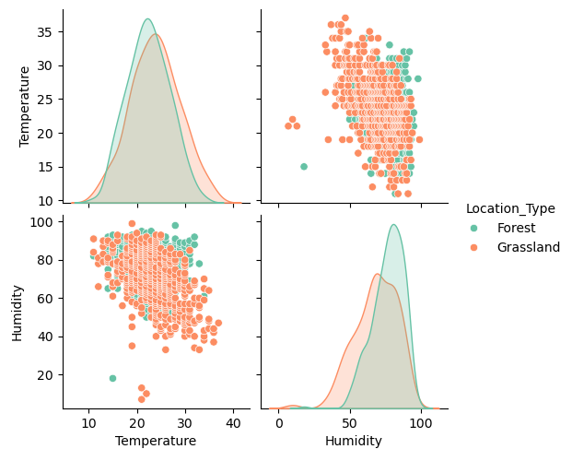
ENVIRONMENTAL ANALYSIS
Relationship between Temperature and Humidity

Slide 17
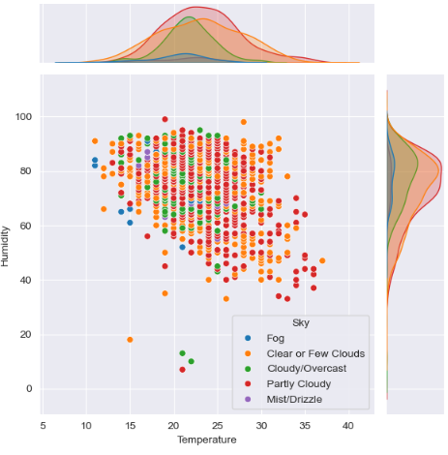
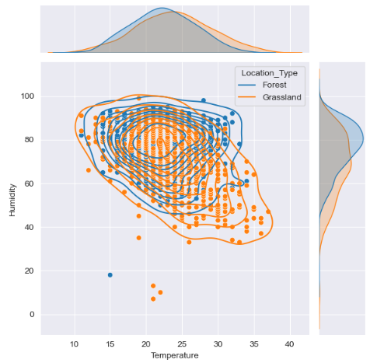
ENVIRONMENTAL ANALYSIS
Observation of Birds - Temperature, Humidity & Sky Condition.
Relationship between Temperature and Humidity
(both ecosystem)

Slide 18
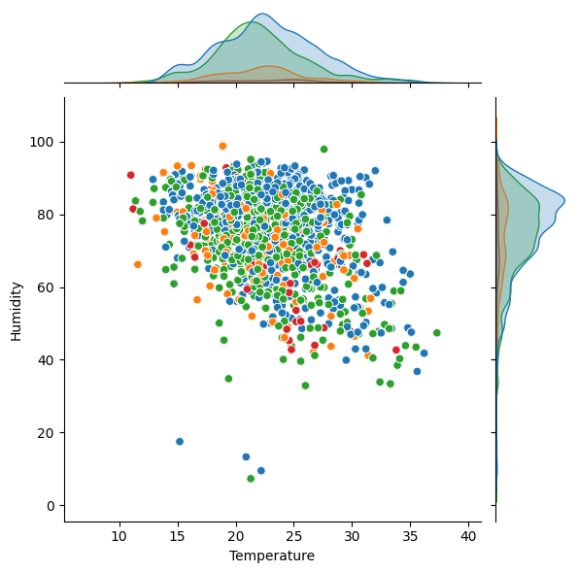

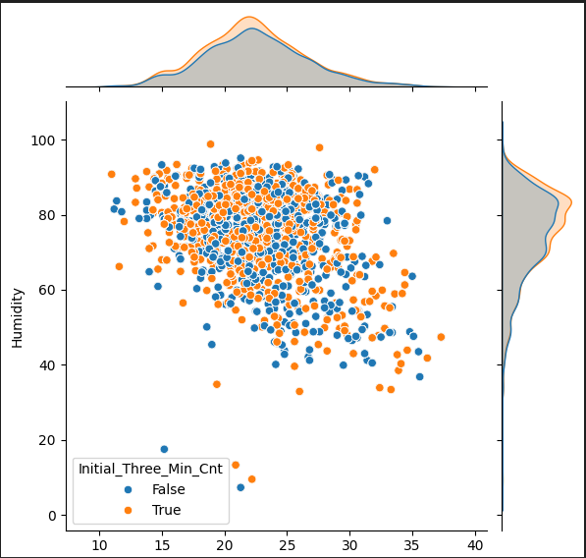
ENVIRONMENTAL ANALYSIS
Observation of Birds - Temperature, Humidity & Disturbance.
Observation of Birds w.r.t Temperature and Humidity

Slide 19
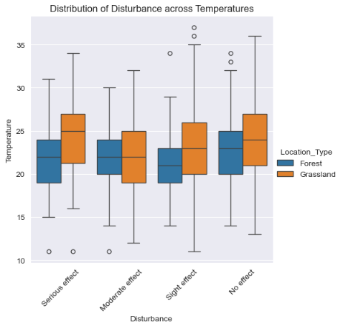
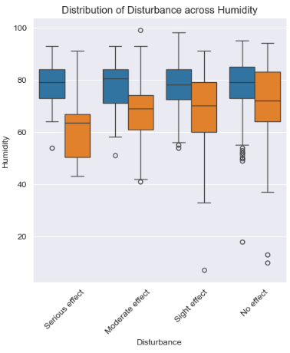
ENVIRONMENTAL ANALYSIS

Slide 20
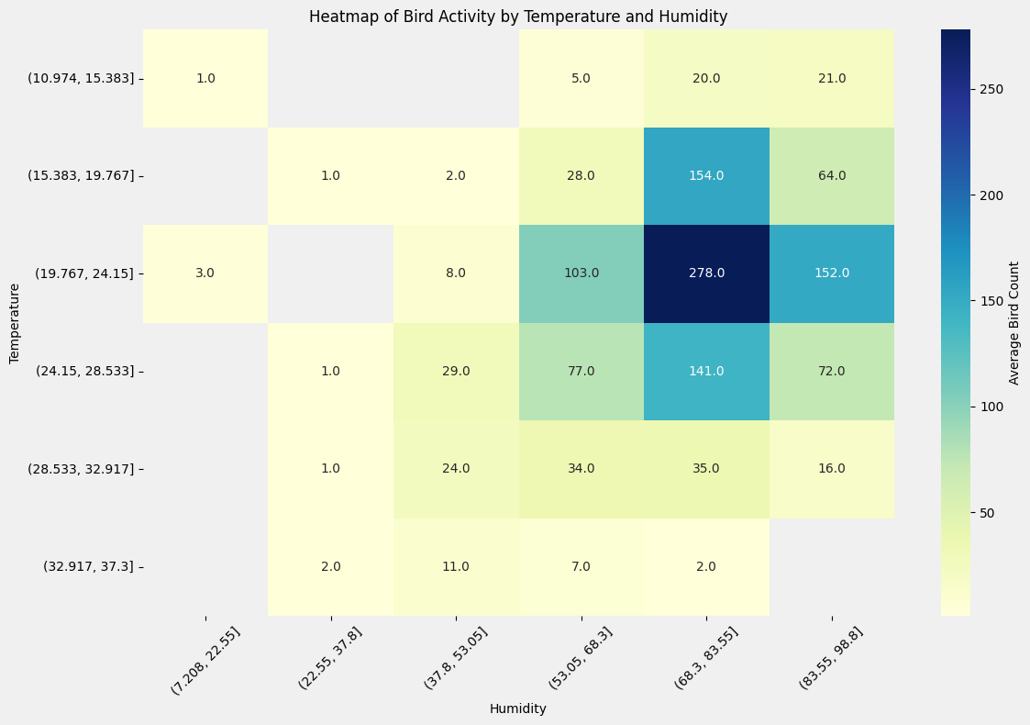
ENVIRONMENTAL ANALYSIS - HEATMAP

Slide 21
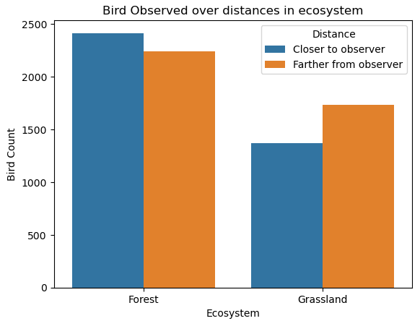
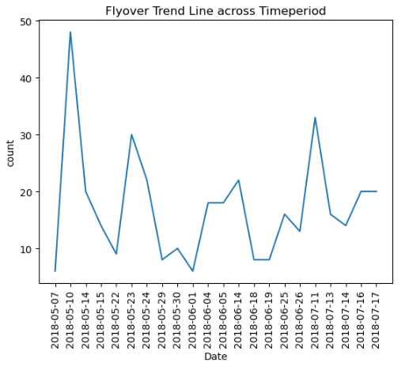
DISTANCE AND BEHAVIOUR ANALYSIS

Slide 22
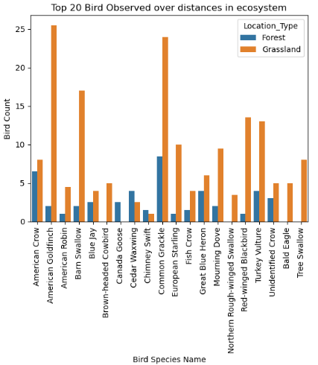
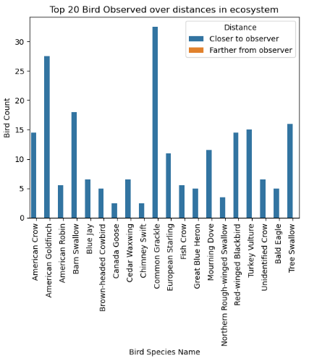
DISTANCE AND BEHAVIOUR ANALYSIS

Slide 23
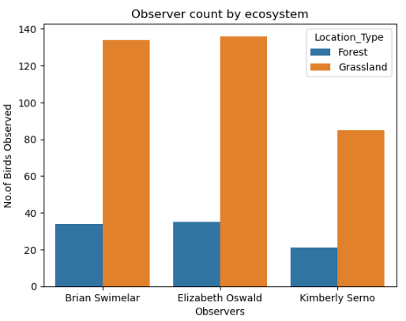
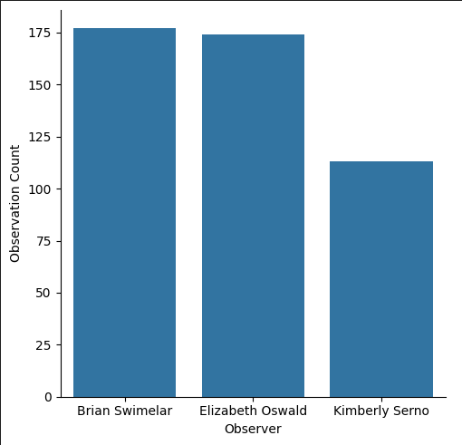
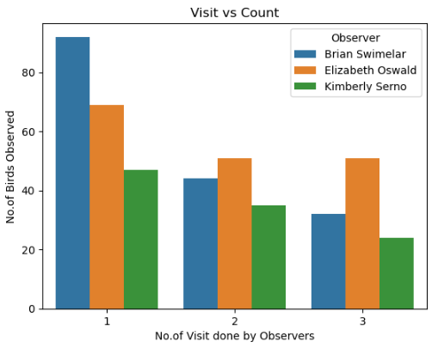
OBSERVER TRENDS
Overall Flyovers observed by Observers

Slide 24
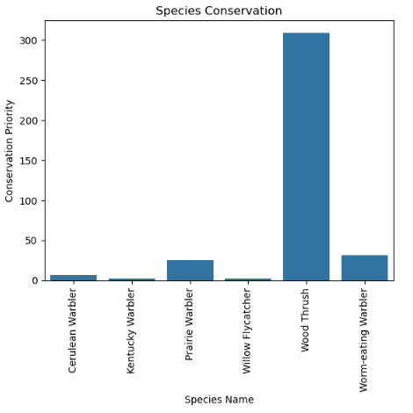
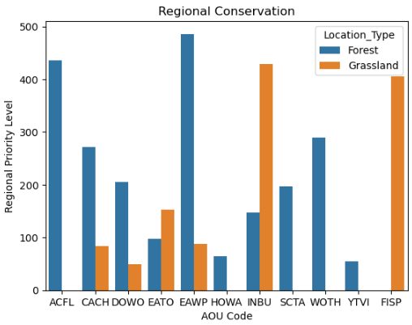
CONSERVATION

